Slide 1

Is a visual search strategy task specific or inherent?
Luis Martín-Roldán (6524877)
Aditya Vardhan(6480039)

Slide 2
Overview
Background
Method
Possible Result
Conclusion
Notes:
Background on visual search topic,
Our RQ and methods employed
What we expect the results to be like and posible conclussions

Slide 3



Background
What do we know
Subjective impression – richly detailed visual world
But,
Differences observed across experiments involving visual search
Notes:
These differences in performance are usually attributed as strategy, that is, the efficiency with which participants control their search to complete the task quickly and accurately.
When you’re looking for something it is right in front of you.. Can’t see it until you bring your attention to it.
Rich visual world, subjective impression -> navigate through rich world using techniques
Studies found difference between participants (information processing ability, speed-accuracy trade-off)
Studies found performance in one task does not predict performance in other tasks. How many strategies are there?

Slide 4
Research Question
Is a strategy adopted/an inherent mechanism or task dependent?
Notes:
An inherent mechanism would be individual specific- a person’s style of problem solving!?!? If it’s the right word
Our ambitious rq is [read]
When solving 2 similar visual search tasks, can our performance in 1 predict our performance in the other? If it can, then the same strategy is used, if it cannot, then it is task dependent.

Slide 5
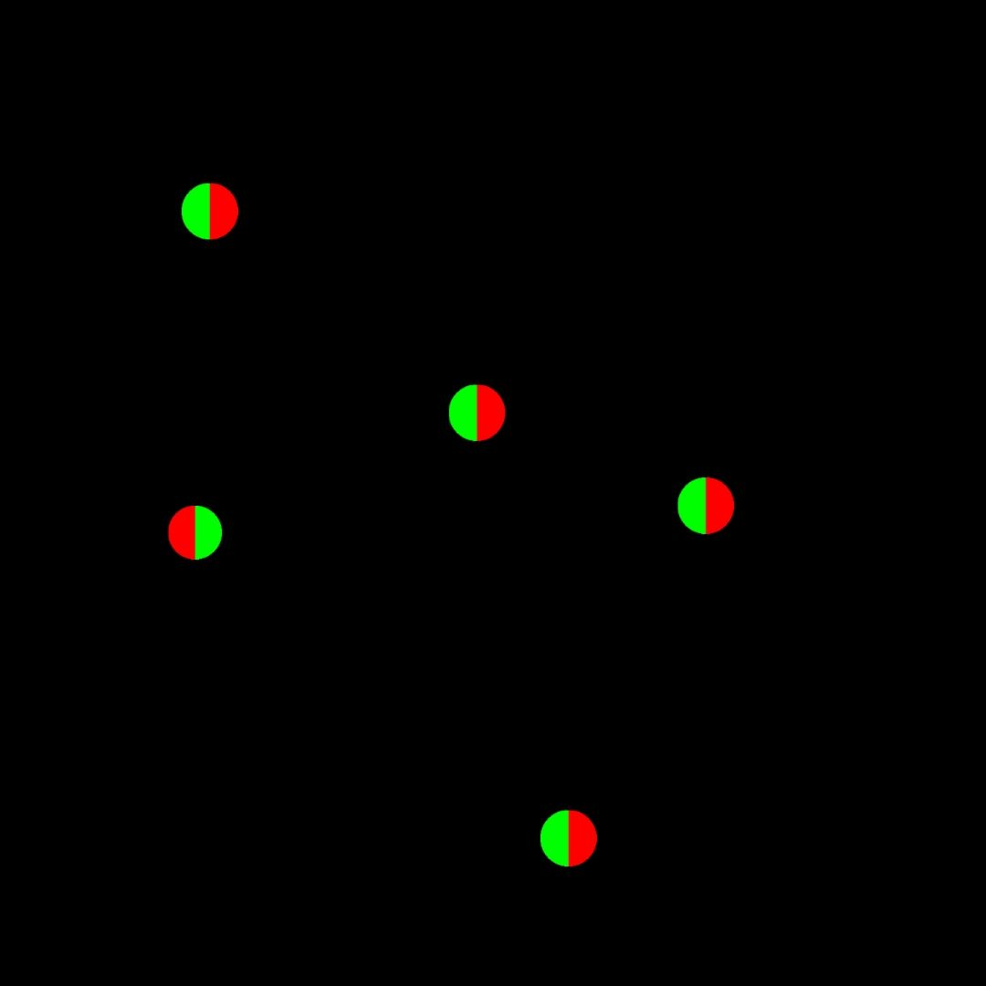
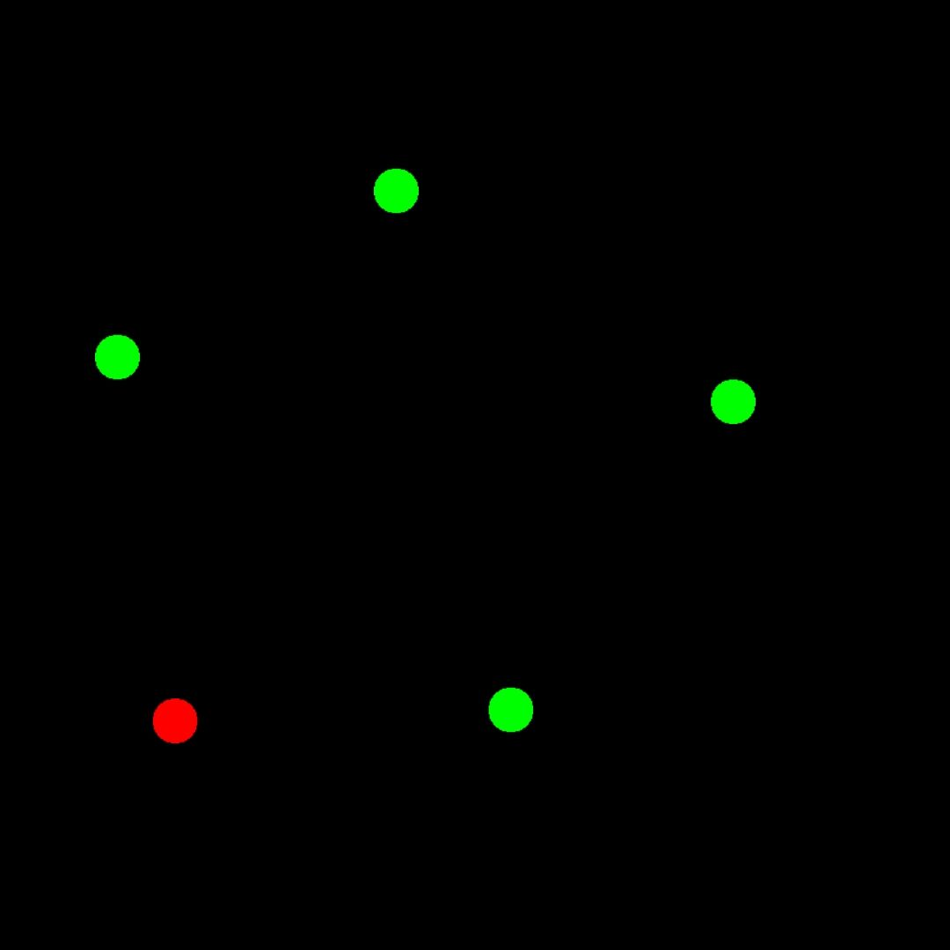
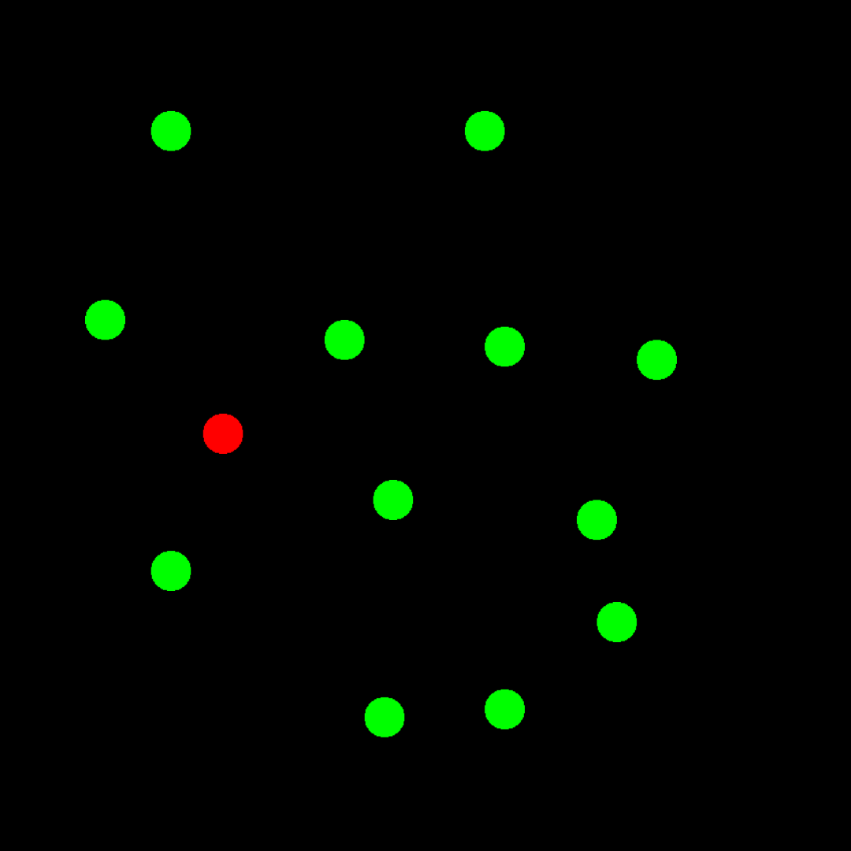
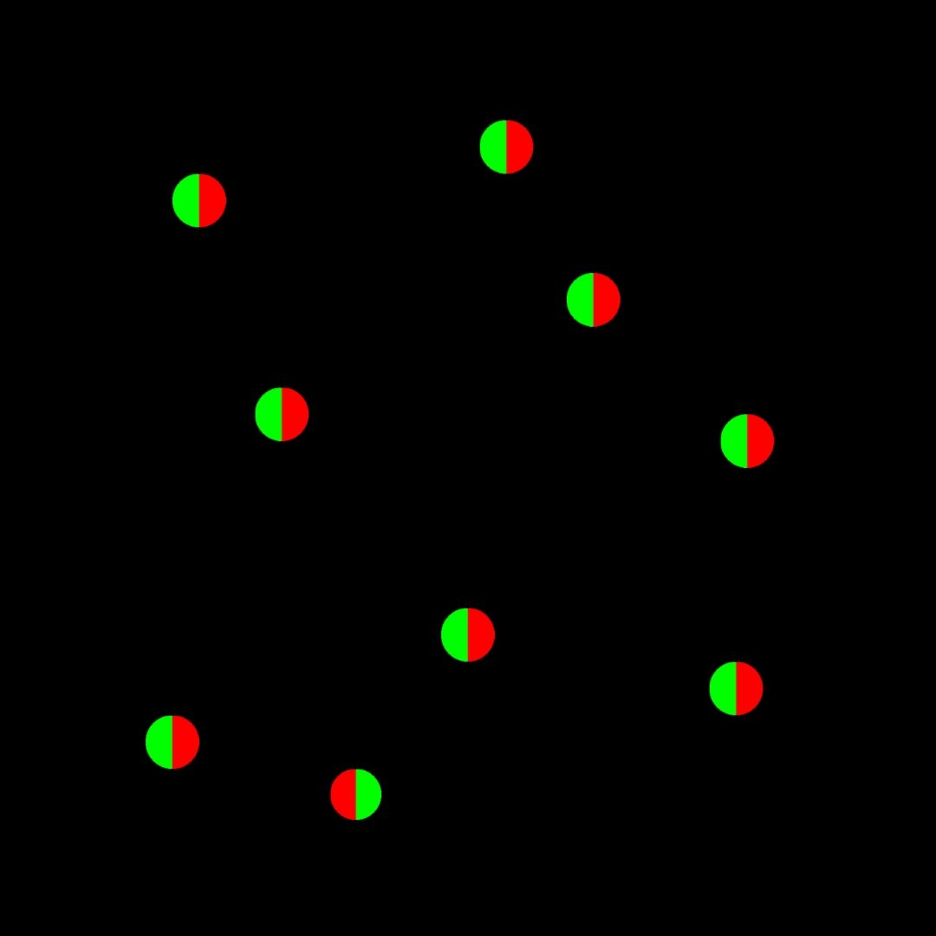
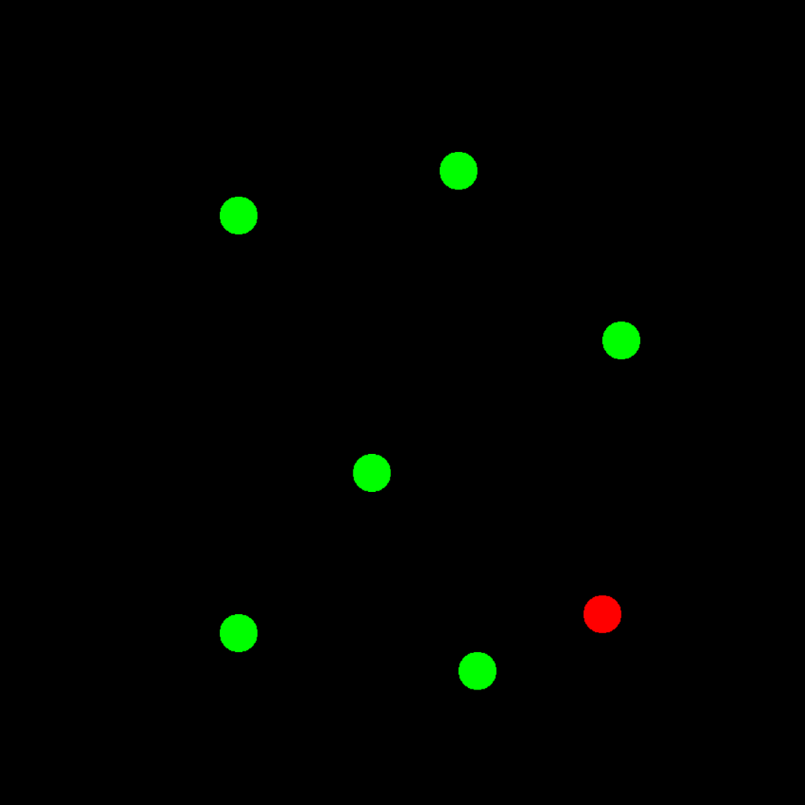
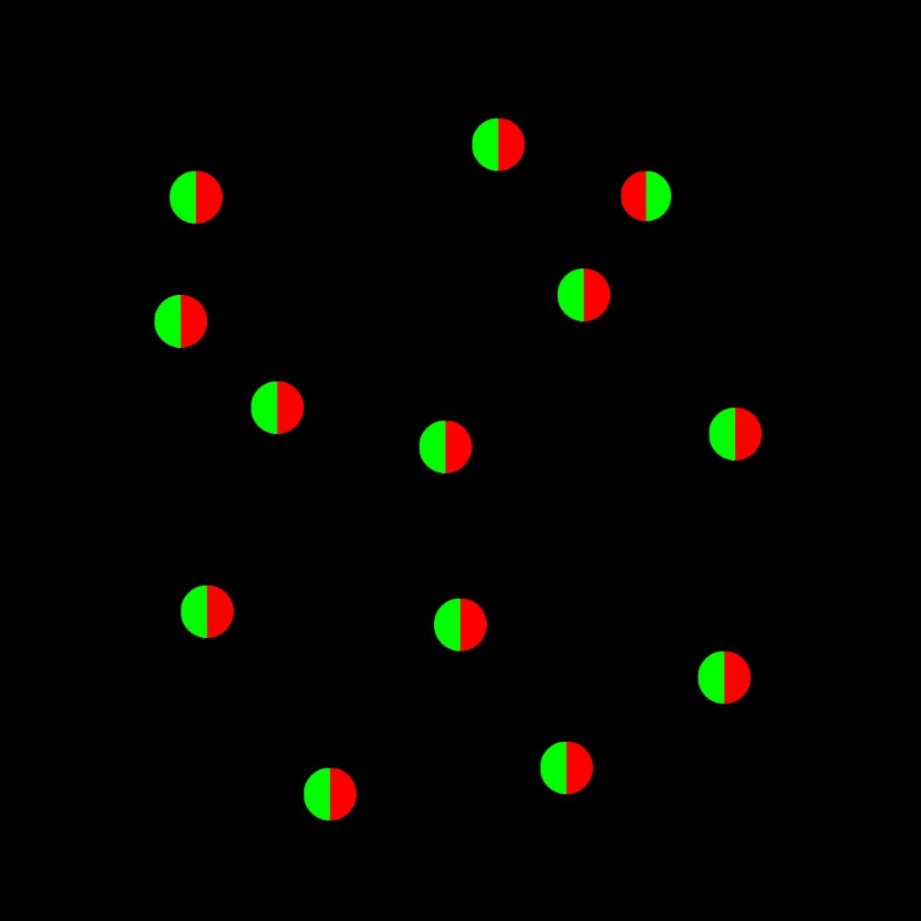
Method
Two Experiments
Easy Task
Hard Task
Same features for stimulus
Shape: Circle
Colour: Red/ Green
Conditions: 5
Trials: Random
Notes:
{Block Size: 4,6,8,10, 12} --- COnditions
For that we will use 2 tests that use the same basic, simple visual features (list) but with 2 levels of difficulty.
Activate similar neuron paths

Slide 6
Possible Method
Statistical tests between subjects, task and conditions
Linear regression to predict and compare strategy using RT.
Notes:
Task- experiment…
Link differences to underlying strategies

Slide 7
Possible Conclusion
Strategy is task specific not a inherent mechanism intrinsic to subject.
Performance and strategy in one tsk does not predict their behaviour in the other.
Notes:
If we can, then a strategy is not task specific and our performance in one of them can serve as predictor to our performance in the other.

Slide 8
Thank you!!!

